Slide 1
Model Evaluation
Lei Qian, Ph.D.

Slide 2
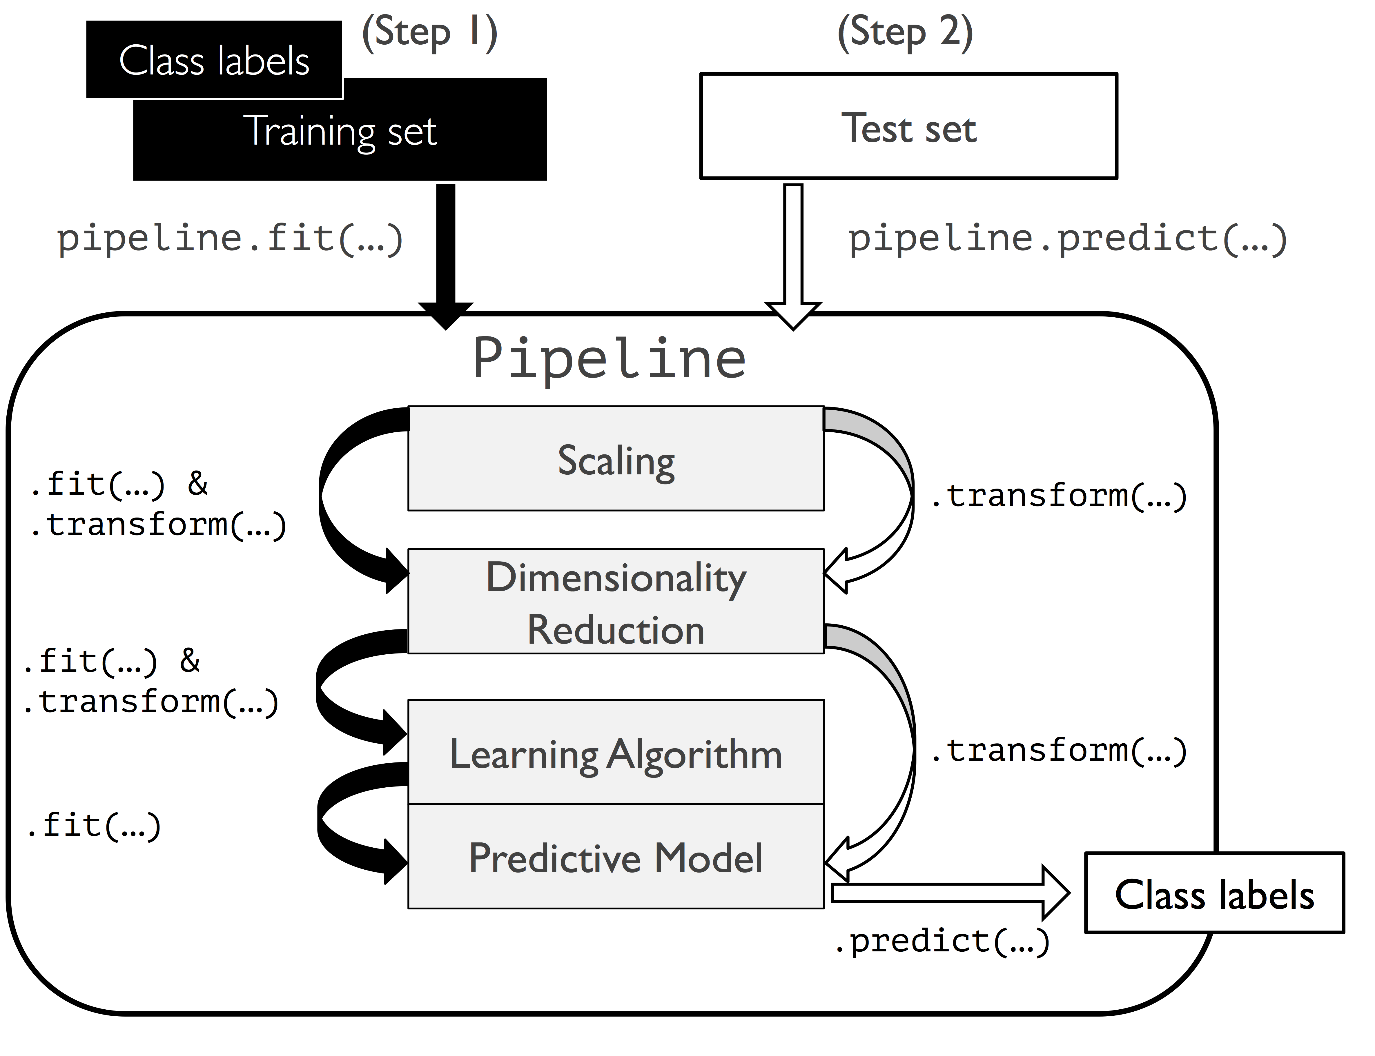
Scikit-Learn Pipeline
Scikit Learn pipeline sequentially apply a list of transforms and a final estimator to datasets. Intermediate steps of the pipeline must be ‘transformers’, that is, they must implement fit and transform methods (for example, scalars). The final estimator only needs to implement fit.
The purpose of the pipeline is to assemble several steps that can be cross-validated together while setting different parameters.

Slide 3
Scikit-Learn Pipeline
pipe_lr = make_pipeline(StandardScaler(),
PCA(n_components=2),
LogisticRegression(random_state=1, solver='lbfgs'))
pipe_lr.fit(X_train, y_train)
y_pred = pipe_lr.predict(X_test)
Note that pipeline itself is a transformer and can be iterated to generate new transformers.

Slide 4
Hyperparameters
A hyperparameter is a parameter whose value is used to control the learning process. By contrast, the values of other parameters (typically node weights) are derived via training.
Examples of Hyperparameters:
Regulation strength (such as C), learning rate, topology of neural networks (number of layers, number of nodes in hidden layers), activation functions, kernel in SVM etc.
Examples of non-hyper parameters:
Weights in neural networks and perceptrons, coefficients in linear and logistic regressions.

Slide 5
Validation Set
We have learned how to use training set and test set to measure the performance of a model. We use training set to train parameters and use test set to evaluate performance. But how do we choose optimal hypterparameters?
We can further split the data set to training set, test set and validation set. A model is trained by training set with different hyperparameters. Validation set help to decide which hyperparameters shall be used. Then we use test set to measure the performance.
Training dataset: tune parameters.
Validation dataset: tune hyperparameters.
Test dataset: measure the performance of the model in real world.

Slide 6
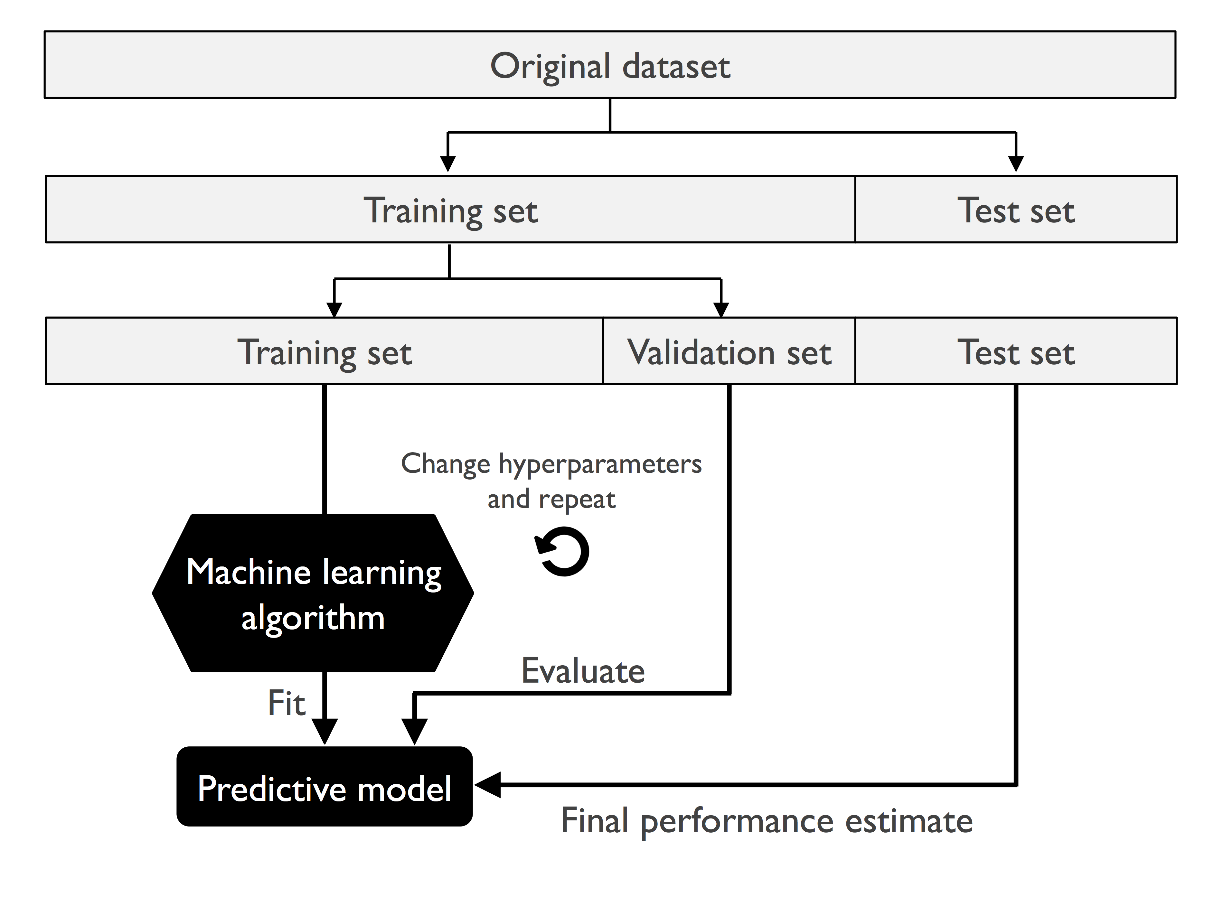
Validation Set

Slide 7
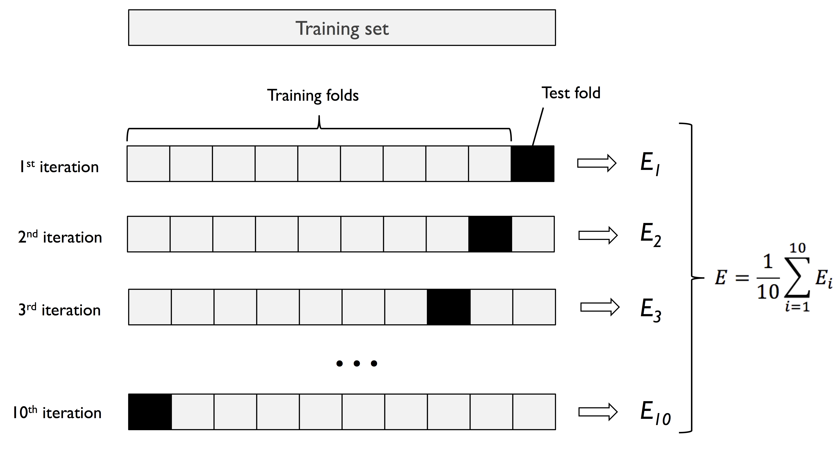
K-fold cross-validation

Slide 8
Workflow for k-fold cross validation
1. Dataset is split into training and test sets.
2. Training set is split into k subsets.
3. Training the model k rounds. In each round, k-1 sets are used as training data and the remaining set is used as test data. The average performance is the performance for the specific set of hyperparameters.
4. Find hyperparameters that give the best average performance.
5. Retrain the whole training set with hyperparemters we obtained in step 4.
6. Use the model trained in step 5 to measure the performance of test set.

Slide 9
Workflow for k-fold cross validation
Usually, large k leads to small bias because more data will be used for training. But it increases the variance and computing time.
We usually use large k for small dataset and small k for large dataset.
An extreme case for k-fold cross-validation is Leave-one-out cross-validation (LOOCV) method. In this case, k=n (the number of samples). In each fold, only 1 sample is left out for testing. This can be used for extremely small dataset.
Stratified k-fold cross-validation is a case of k-fold validation that the class proportions are preserved in each fold to ensure that each fold is representative of the class proportions in the training dataset. This is particularly useful in case of unequal class proportions.

Slide 10
Workflow for k-fold cross validation
The easiest way to run cross-validation is by using cross_val_score method in scikit-learn:
scores = cross_val_score(estimator=pipe_lr,
X=X_train,
y=y_train,
cv=10,
n_jobs=1)

Slide 11
Learning Curves
A learning curve shows the validation and training score of an estimator for varying numbers of training samples. It is a tool to find out how much we benefit from adding more training data and whether the estimator suffers more from a variance error or a bias error. If both the validation score and the training score converge to a value that is too low with increasing size of the training set, we will not benefit much from more training data.

Slide 12
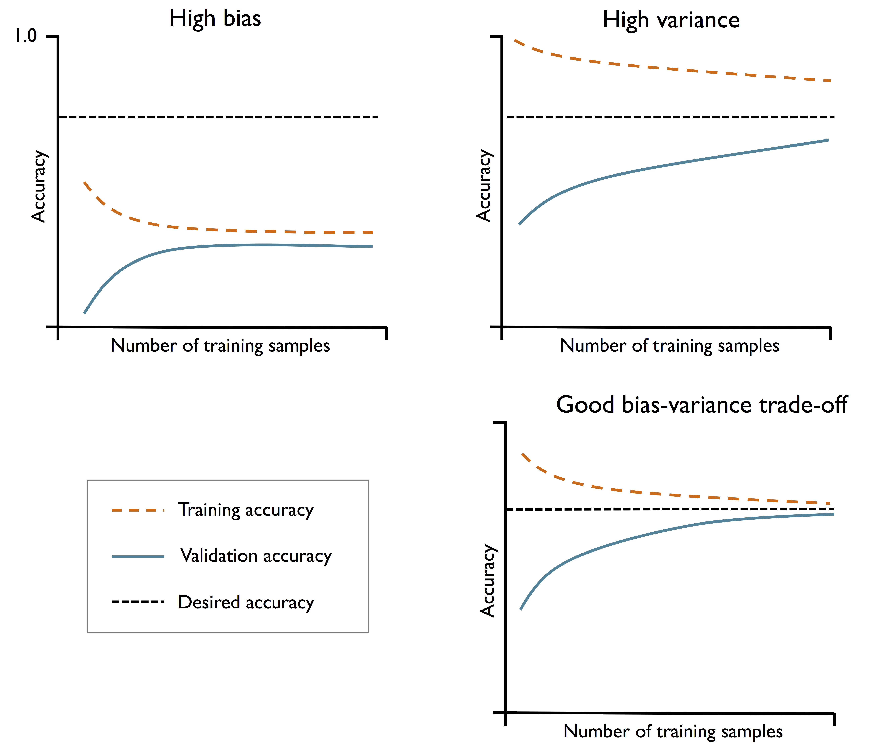
Learning Curves

Slide 13
Learning Curves
learning_curve(estimator=pipe_lr, X=X_train, y=y_train,
train_sizes=np.linspace(0.1, 1.0, 10), #train size from 10% to 100%
cv=10,
scoring='accuracy', #scoring metrics. default value is None, which uses
#accuracy as the score.
n_jobs=6) # number of jobs.
We can also use precision, recall, or f1 as options of scoring.

Slide 14
Validation Curves
Validation curves are a useful tool for improving the performance of a model by addressing issues such as overfitting or underfitting.
Validation curves are related to learning curves, but instead of plotting the training and test accuracies as functions of the sample size, we vary the values of the model parameters, for example, the inverse regularization parameter C in logistic regression.

Slide 15
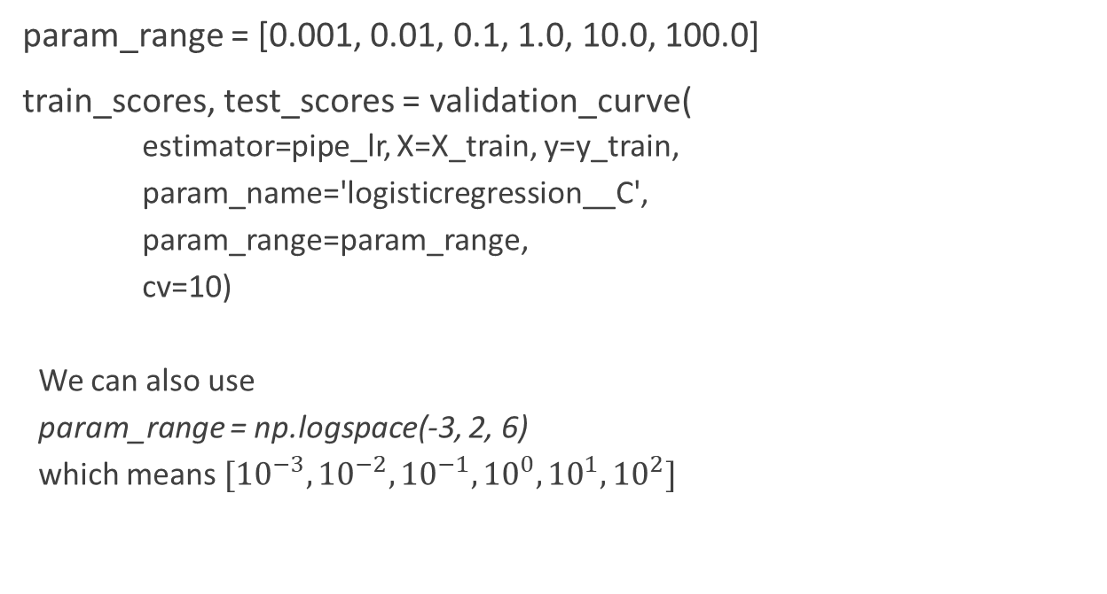
Validation Curves
param_range = [0.001, 0.01, 0.1, 1.0, 10.0, 100.0]
train_scores, test_scores = validation_curve(
estimator=pipe_lr, X=X_train, y=y_train,
param_name='logisticregression__C',
param_range=param_range,
cv=10)
We can also use
param_range = np.logspace(-3, 2, 6)
which means $[{10}^{−3},{10}^{−2},{10}^{−1},{10}^{0},{10}^{1},{10}^{2}]$

Slide 16
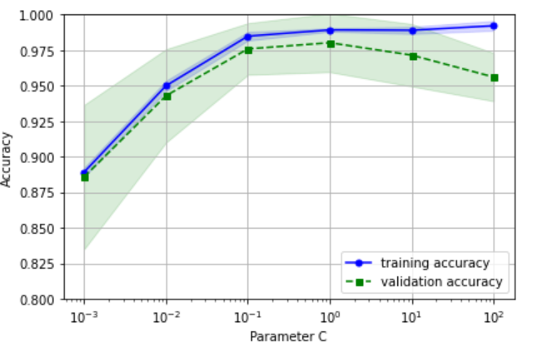
Validation Curves

Slide 17
Grid Search
The approach of grid search is brute-force exhaustive search from a list of values for different hyperparameters, and the computer evaluates the model performance for each combination of those to obtain the optimal combination of values from this set.

Slide 18
Grid Search
param_grid = [{'svc__C': param_range, 'svc__kernel': ['linear']},
{'svc__C': param_range,
'svc__gamma': param_range,
'svc__kernel': ['rbf']}]
gs = GridSearchCV(estimator=pipe_svc,
param_grid=param_grid,
scoring='accuracy',
cv=10,
n_jobs=-1)
gs = gs.fit(X_train, y_train)

Slide 19
Nested cross-validation
K-fold cross-validation can be used for tuning hyperparameters (validation). It can also be used for evaluating performance of models. Nested cross-validation can combine both to use two levels of cross-validation to do both hyperparameter tuning and performance evaluation!

Slide 20
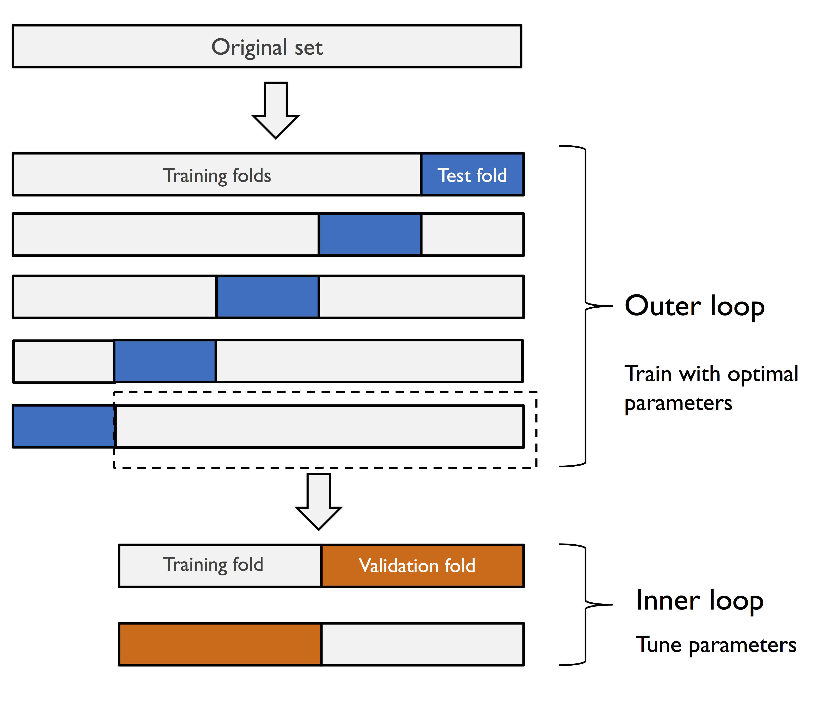
Nested cross-validation

Slide 21
Nested cross-validation
gs = GridSearchCV(estimator=pipe_svc,
param_grid=param_grid,
scoring='accuracy',
cv=2)
scores = cross_val_score(gs, X_train, y_train,
scoring='accuracy', cv=5)
Note that we use the GridSearchCV object as an estimator in the cross_val_score function.

Slide 22
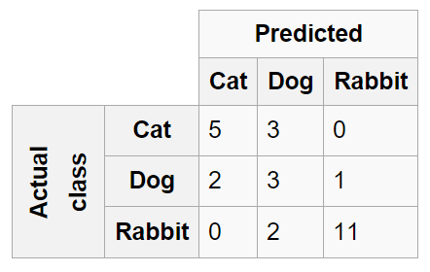
Multiple Class Classification -Confusion Matrix
A specific table layout that allows visualization of the performance of an algorithm

Slide 23
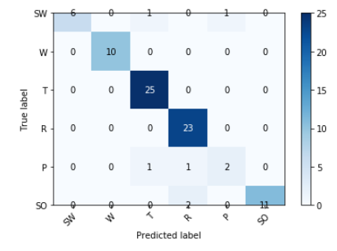
Confusion Matrix

Slide 24
Binary Classification and Accuracy
Accuracy alone may not be a good measurement for a prediction algorithm:
Example:
The infection rate of COVID is 10%.
A test T's false negative rate is 20%. That means if test results are negative, 20% of them may still have the disease.
We assume the false positive rate is 20%. That means if the test reports positive, the tester is indeed gets COVID.
The accuracy of antigen is 80%.
Assume a fake test reports all people have no COVID, the accuracy is 90%, which is higher than the test T.

Slide 25
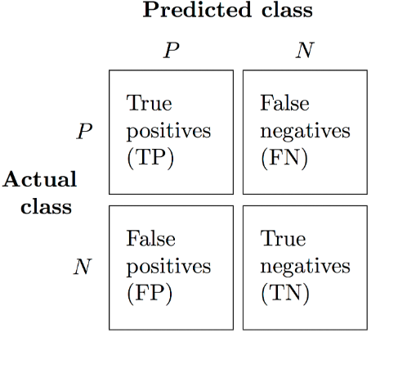
Binary Classification
For binary classification test:
True positive (TP): positive samples that are correctly classified as positive.
True negative (TN): negative samples that are correctly classified as negative.
False positive (FP): negative samples that are incorrectly classified as positive.
False negative (FN): positive samples that are incorrectly classified as negative.
Accuracy = $\frac{TP+TN}{TP+FP+FN+TN}$

Slide 26
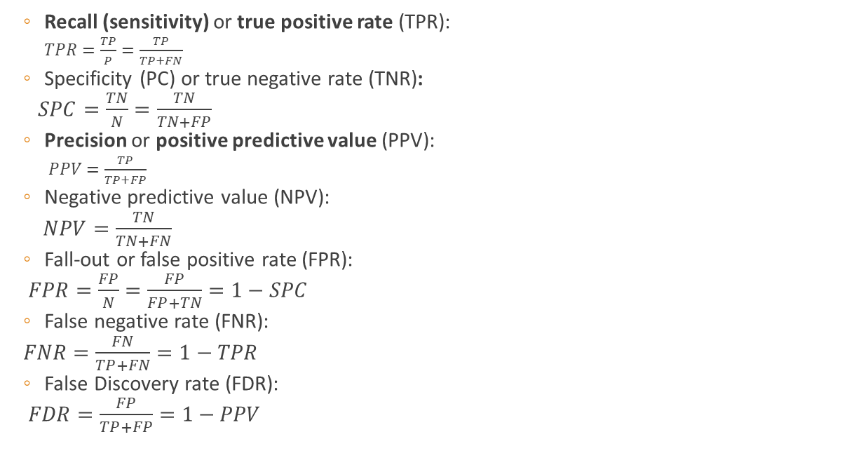
Binary Classification
Recall (sensitivity) or true positive rate (TPR):
$TPR=\frac{TP}{P}=\frac{TP}{TP+FN}$
Specificity (PC) or true negative rate (TNR):
$SPC=\frac{TN}{N}=\frac{TN}{TN+FP}$
Precision or positive predictive value (PPV):
$PPV=\frac{TP}{TP+FP}$
Negative predictive value (NPV):
$NPV=\frac{TN}{TN+FN}$
Fall-out or false positive rate (FPR):
$FPR=\frac{FP}{N}=\frac{FP}{FP+TN}=1−SPC$
False negative rate (FNR):
$FNR=\frac{FN}{TP+FN}=1−TPR$
False Discovery rate (FDR):
$FDR=\frac{FP}{TP+FP}=1−PPV$

Slide 27
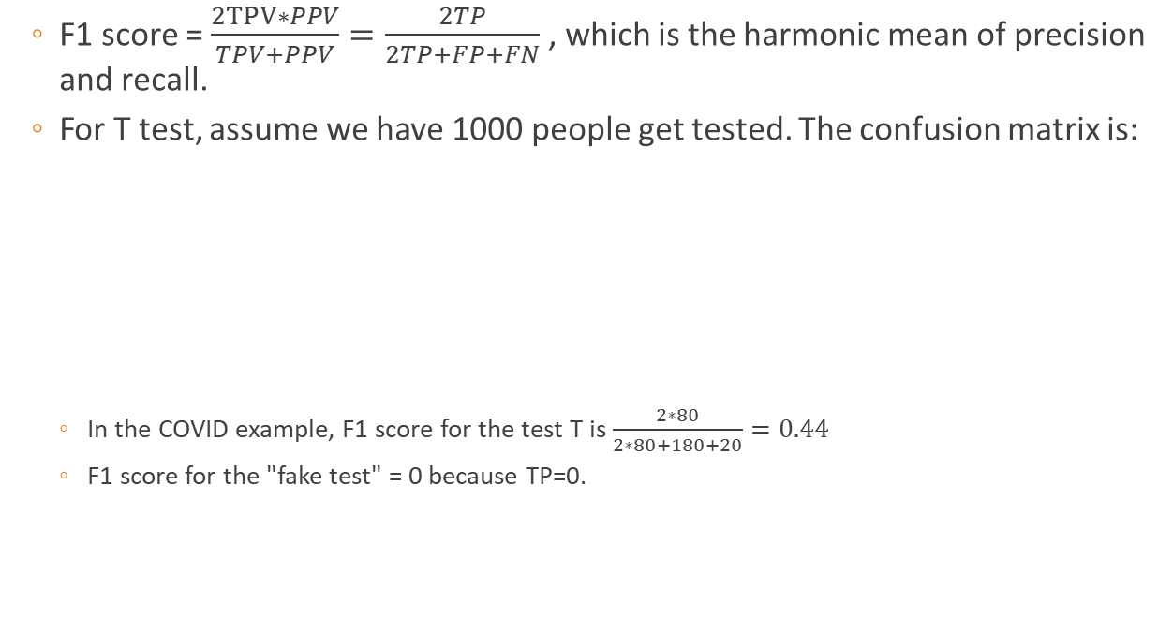
Binary Classification
F1 score = $\frac{2TPV∗PPV}{TPV+PPV}=\frac{2TP}{2TP+FP+FN}$ , which is the harmonic mean of precision and recall.
For T test, assume we have 1000 people get tested. The confusion matrix is:
In the COVID example, F1 score for the test T is $\frac{2∗80}{2∗80+180+20}=0.44$
F1 score for the "fake test" = 0 because TP=0.
 | Lable True | Label False
Actual True | 80 (TP) | 20 (FN)
Actual False | 180 (FP) | 720 (TN)

